Slide 1


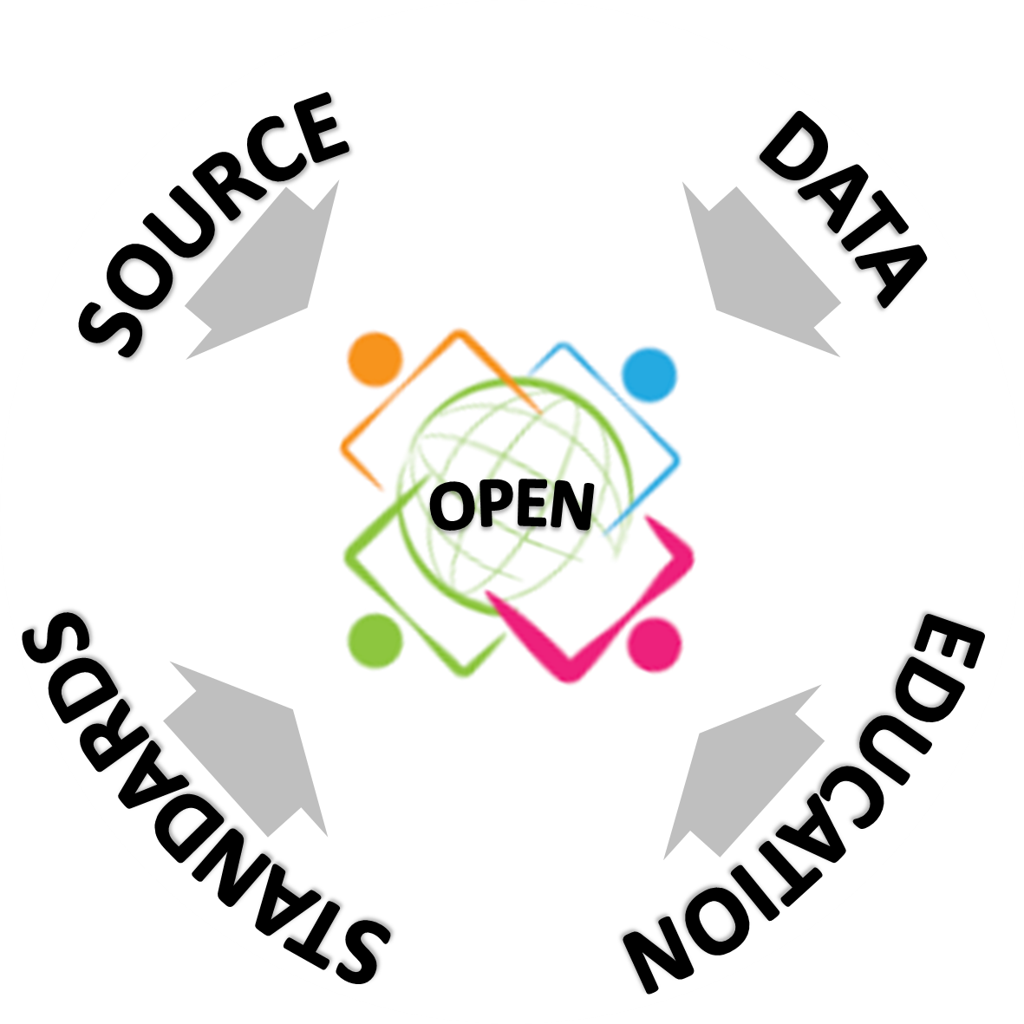


Experiences on How Openness Can Help to Reduce Inequality
Federal University of Paraná
Department of Geomatics
Silvana Philippi Camboim - silvanacamboim@gmail.com
ICA Commission on Open Source Geospatial Technologies
SOURCE
DATA
OPEN
OPEN
STANDARDS
EDUCATION

Slide 2
There are many dimensions to “Open”
source software.
data.
standards.
access to research publications.
education resources.
OPEN

Slide 3
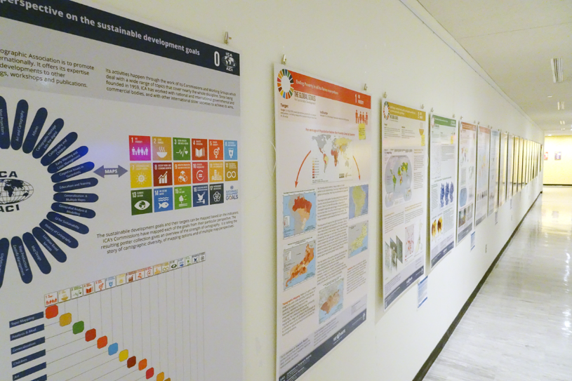
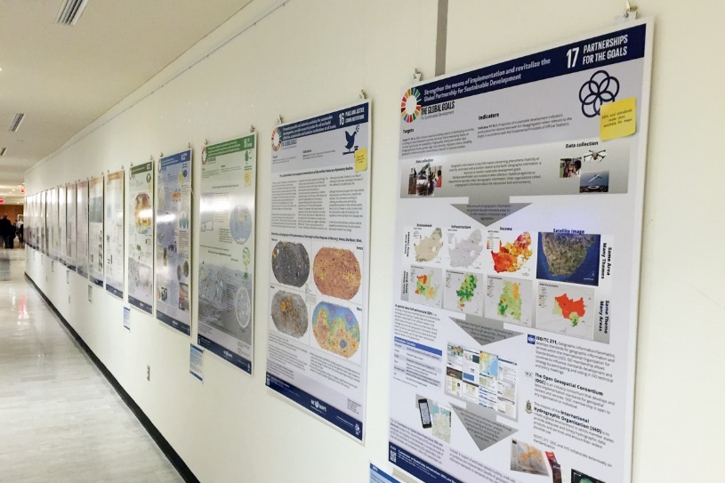
ICA posters on display at the United Nations Headquarters in New York
During the sixth session of the Committee of Experts on Global Geospatial Information Management (UN-GGIM, 3–5 August 2016), the posters created by ICA’s Commissions on the Sustainable Development Goals were on exhibit in the conferences area in United Nations Headquarters in New York. During the opening session the participants were pointed to the exhibition of the ICA posters. During the first day of the conference the exhibition catalog was distributed to all participants. ICA’s contribution to the Sustainable Development Goals was well received.
The posters as well as the catalog for the poster exhibition can be found on
icaci.org/maps-and-sustainable-development-goals.
Let’s make the world a better place with maps!
Menno-Jan Kraak – President of the International Cartographic Association.

Slide 4

Geo for all Cartographic Challenge
UN Sustainable Developent Goals

Slide 5
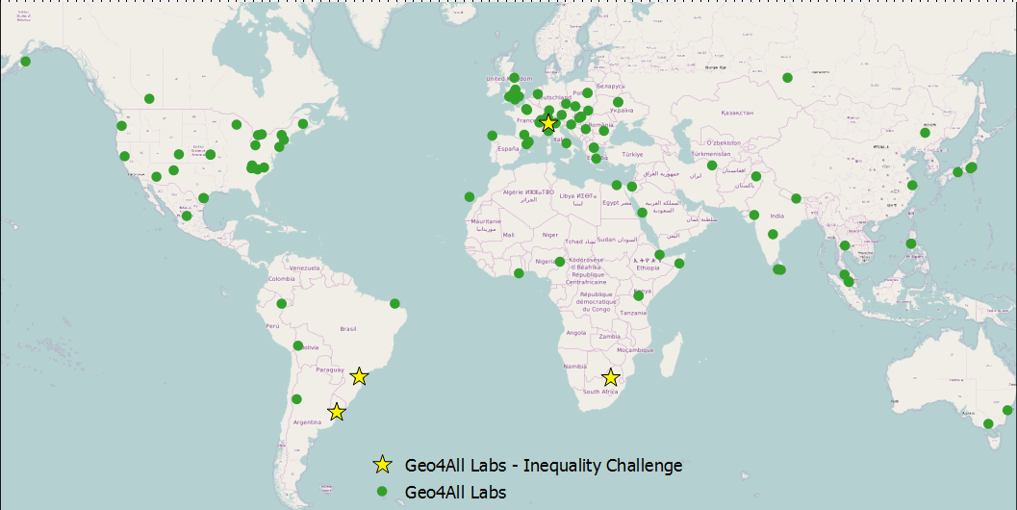
Geo for all Cartographic Challenge
GEOFOR ALL
"Making geospatial education and opportunities accessible to all"
.
110 Geo4All Labs worldwide

Slide 6
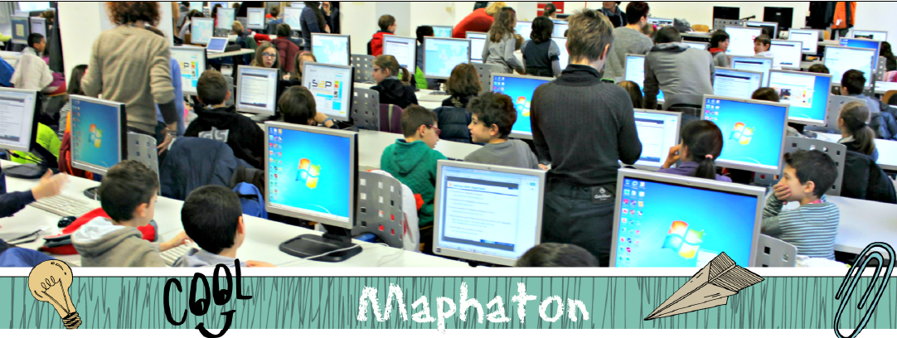
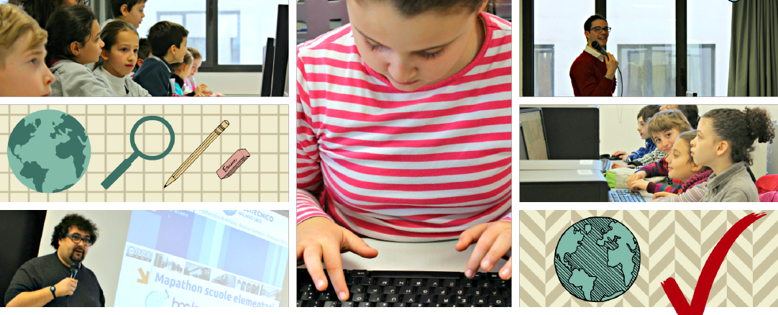

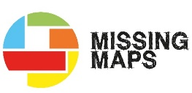
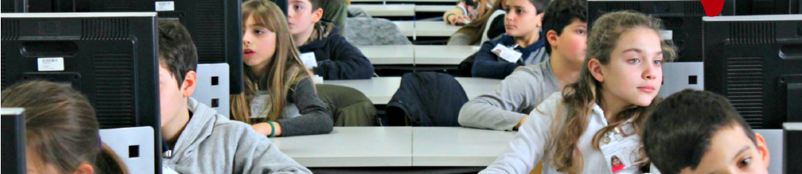
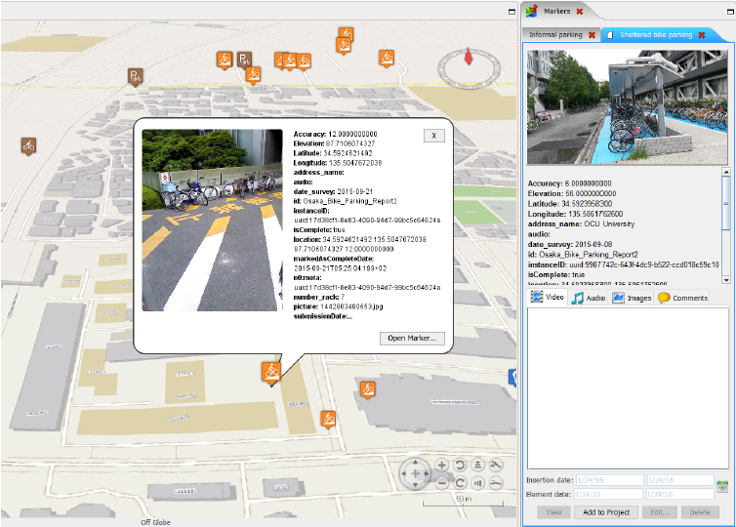
GEOlab IN ACTION
GEOlab – Geomatics and Earth Observation laboratory, Politecnico di Milano,Italy
GEOlab is actively collaborating with the Humanitarian OpenStreetMap Team (HOT) and the Missing Maps project to organize and run humanitarian mapathons. Lots of events have been organized over the last year, both for helping in providing maps after natural disasters (e.g. the mapathon after the Nepal's earthquake in April 2015). A world record mapathon with more than two hundred 10 yearold children was held in March 2016.
A Volunteered Geographic Information (VGI) collaborative platform named PoliCrowd has been developed since 2013. Based on NASA World Wind virtual globe, it is a multidimensional and multithematic platform to organize, visualize and collaboratively enrich VGI collected through mobile devices.
GeoLAB is also involved in teaching and research using Open Source platforms, and organizing FOSS4G events.

Slide 7
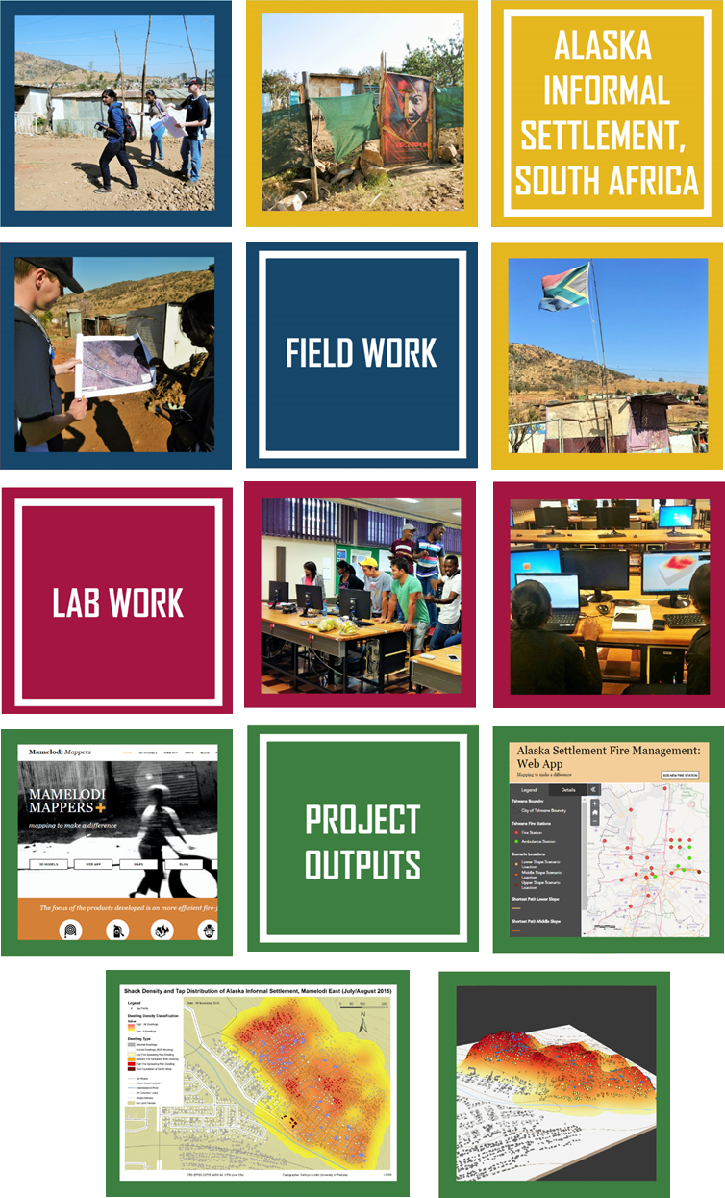
Centre for Geoinformation Science (CGIS), University of Pretoria, South Africa
VIVA GIS!
EMPOWERMENT THROUGH MAPPING
In 20l5, the University of Pretoria partnered with the Viva Foundation, in the Alaska informal settlement in the City of Tshwane, to start a project that aimed to ultimately empower the settlement. The project was driven by the ﬁnal year geoinformatics students in the CGIS.
The first phase was the mapping of the settlement. Data such as dwelling numbers, location of taps and point of interest and footpaths were captured.
Four projects were identified to implement a web GIS solution: Fire safety and Management, Health Care, Service Delivery and Security and Surface Run off Risk Zones.
The final results of the projects were a series of maps, web applications, 3D models and a blog per project group documenting their experience.

Slide 8
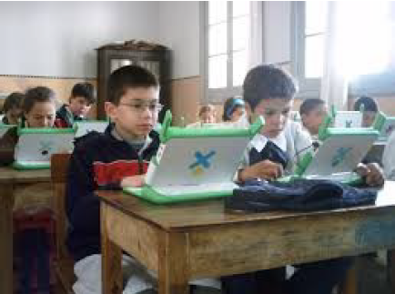
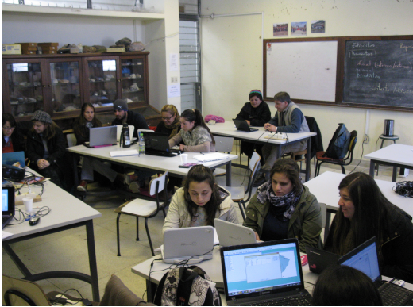
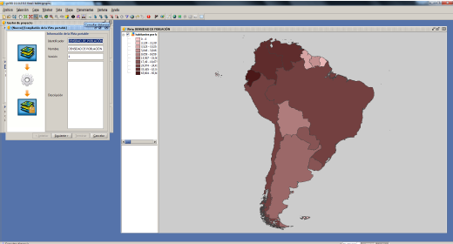

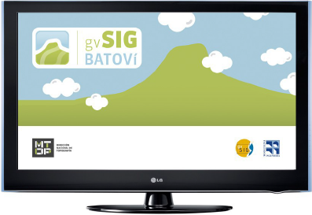
Direccion Nacional de Topografia – MTOP, Uruguay
GVSIG BATOVI
gvSIG Batoví is a open GIS (Geographic Information System) software tool applied to educational environments through which Primary and Secondary students can acquire knowledge of geography using laptops through didactic and interactive information.
Primary and Secondary students can make their own thematic maps
Knowledge of geography in an attractive, motivating and interactive environment
The tool, after its launch, became the first Uruguayan distribution that gives rise to gvSIG Educa, which aims to be a tool for educators to provide students a better analysis and understanding of the territory, as well as collaborate with the assimilation of special concepts using visual tools.

Slide 9
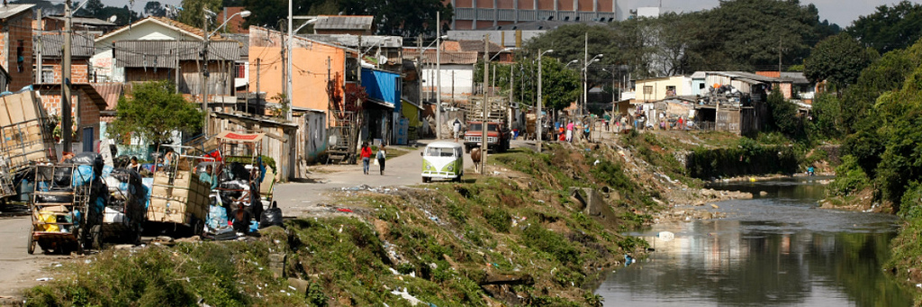
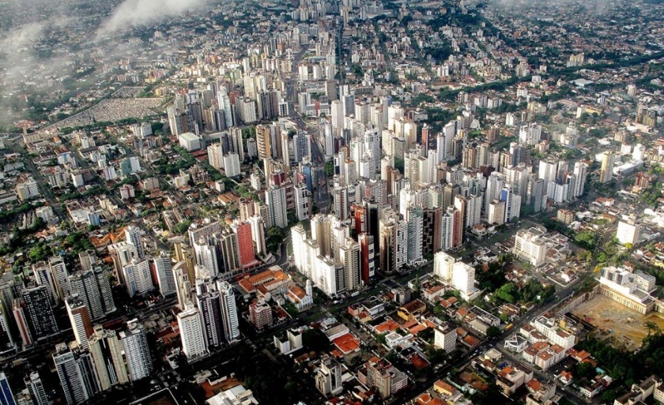
Labgeolivre, Federal University of Paraná, Brazil
Mapping inequalities in Curitiba, Brazil

Slide 10
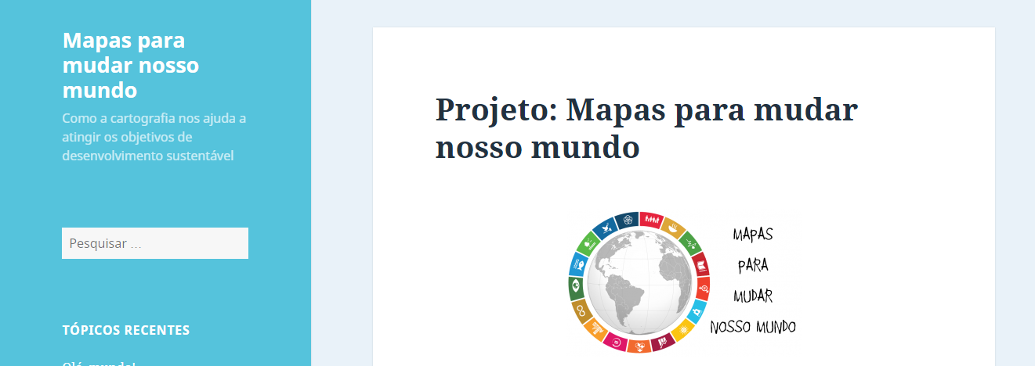
Geo for all Cartographic Challenge - UFPR
Undergraduate students proposed their maps that where made available in a blog: “Mapas para mudar o mundo”

Slide 11
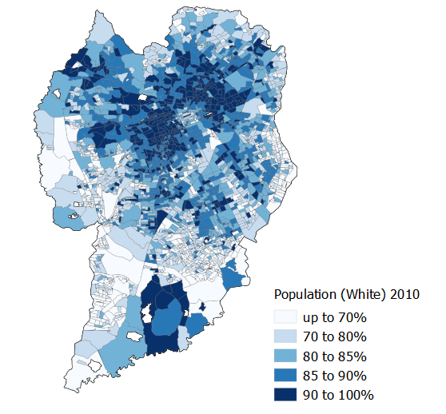
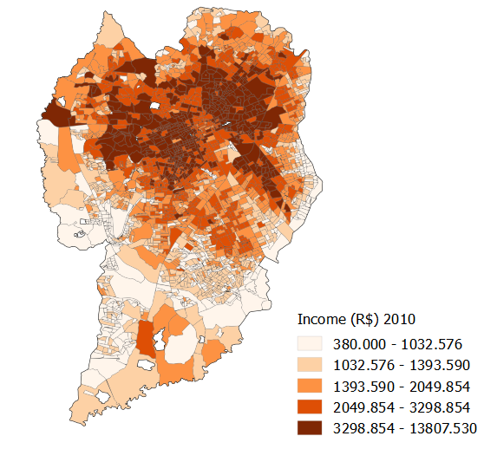
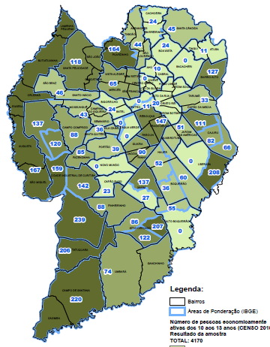
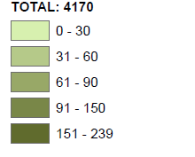
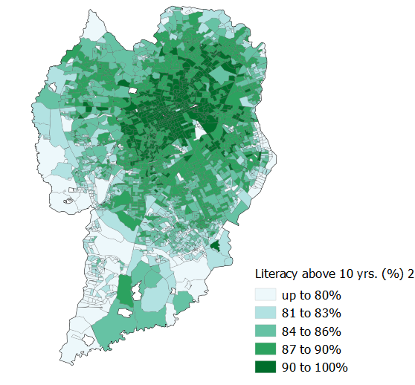
Geo for all Cartographic Challenge - UFPR
The winner project: Mapping Inequalities in Curitiba using QGIS and Open Data

Slide 12
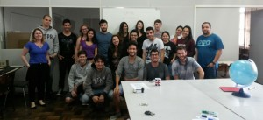
Geo for all Cartographic Challenge - UFPR
Other activities
Mapathons
... BUT... and the local Knowledge?

Slide 13
Working with communities
Some problems... Are the:
Interfaces?
Data Models?
Symbology?
... appropriate for the community needs?

Slide 14
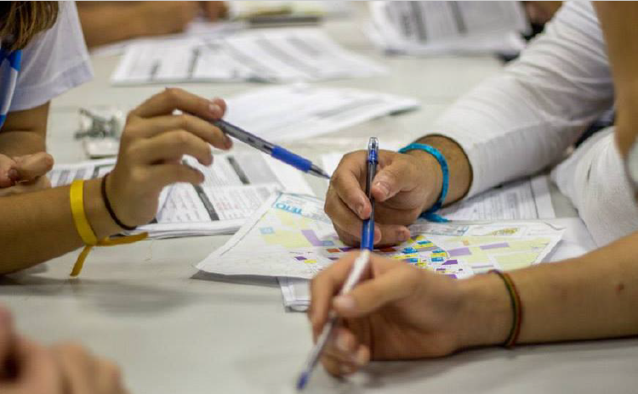
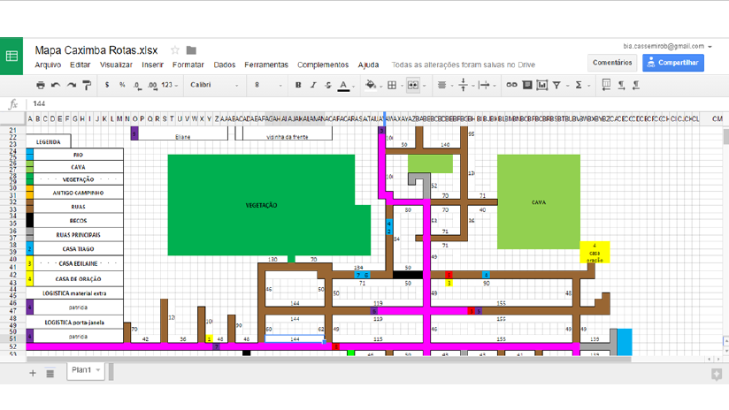
Examples – NGO Teto/Techo

Slide 15
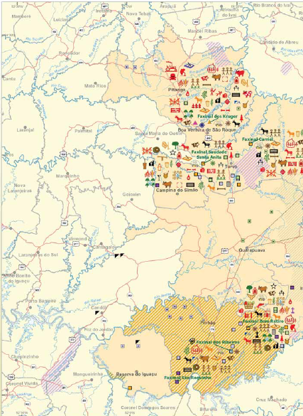
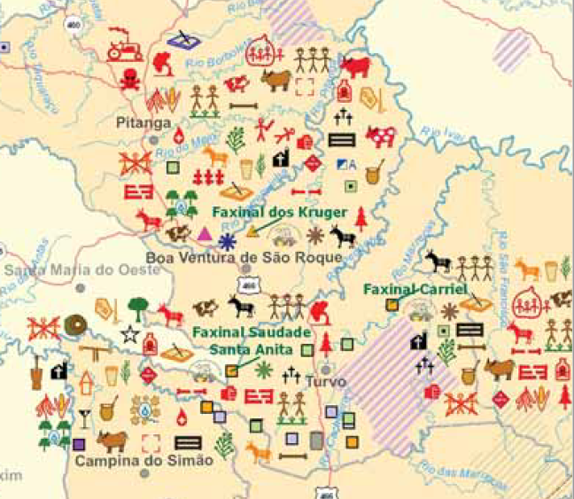
Examples – Social Cartography

Slide 16
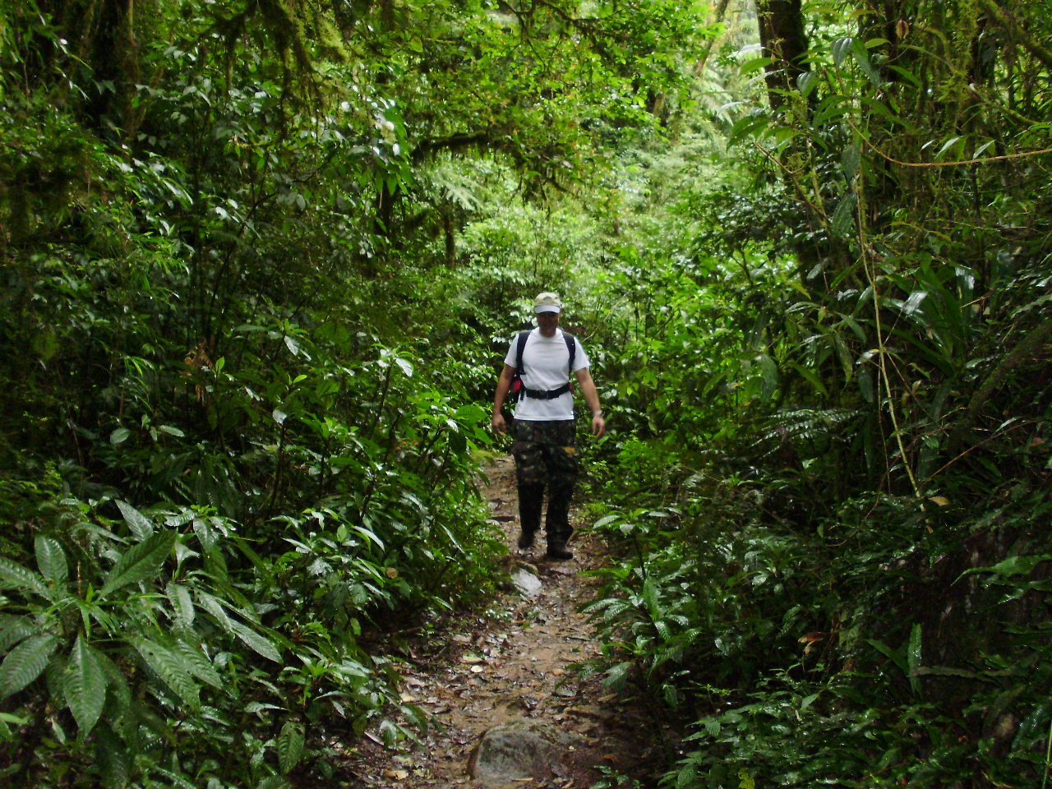
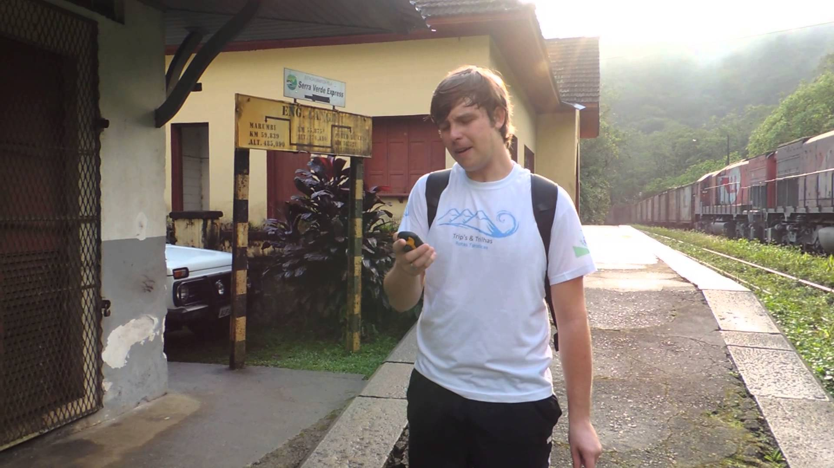
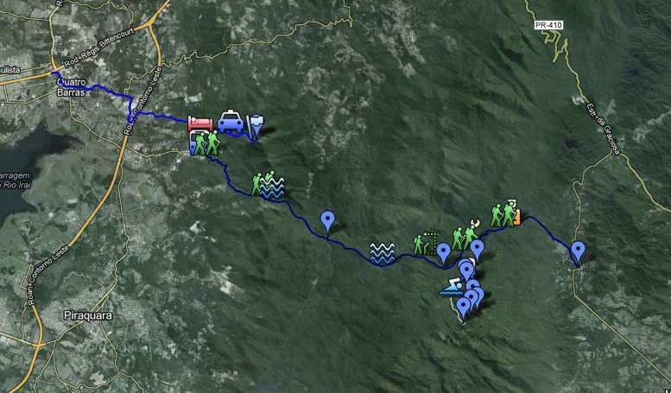
Current Research
VGI to Outdoor Trails (recreation and management perspective):
Users needs? (e.g. Points of Interest)
Suitable Interface, Data Model and Symbology

Slide 17
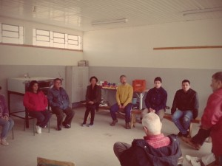
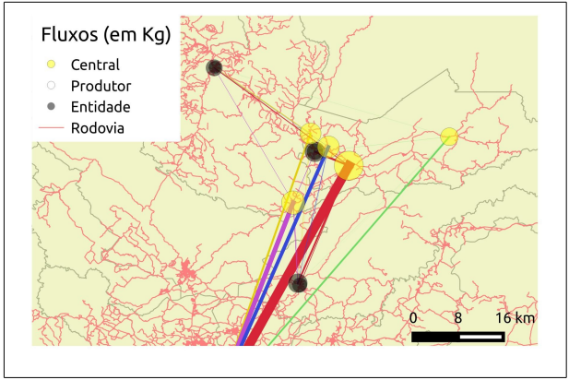
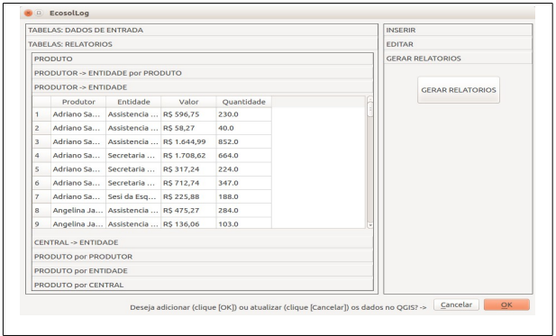
Current Research
VGI to Support the Management of the Local Farmers to School Food Program (Food Security)
Partnership with Local Farmers Association
QGIS Interface

Slide 18
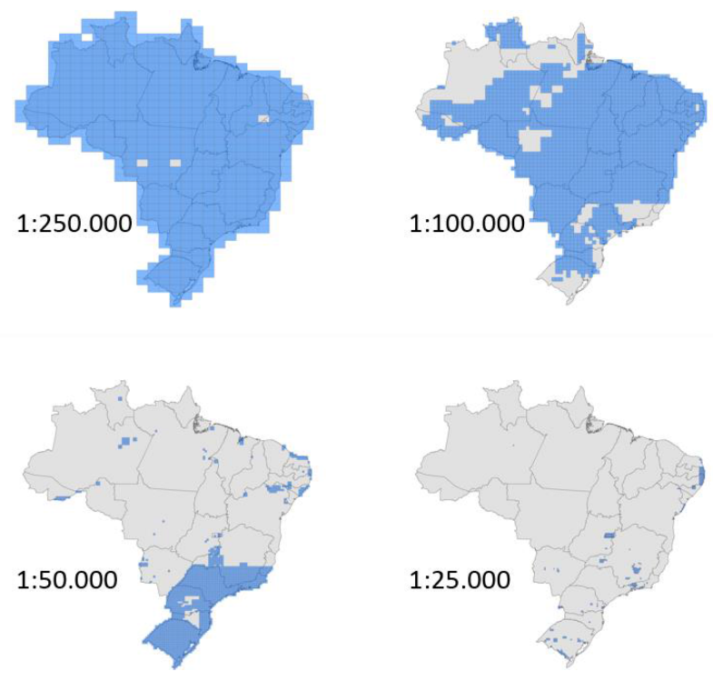
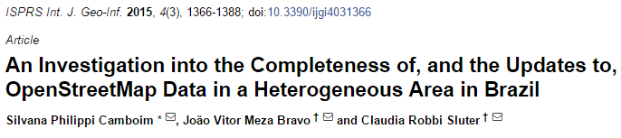
Current Research
VGI to support the lack of offical reference maps

Slide 19
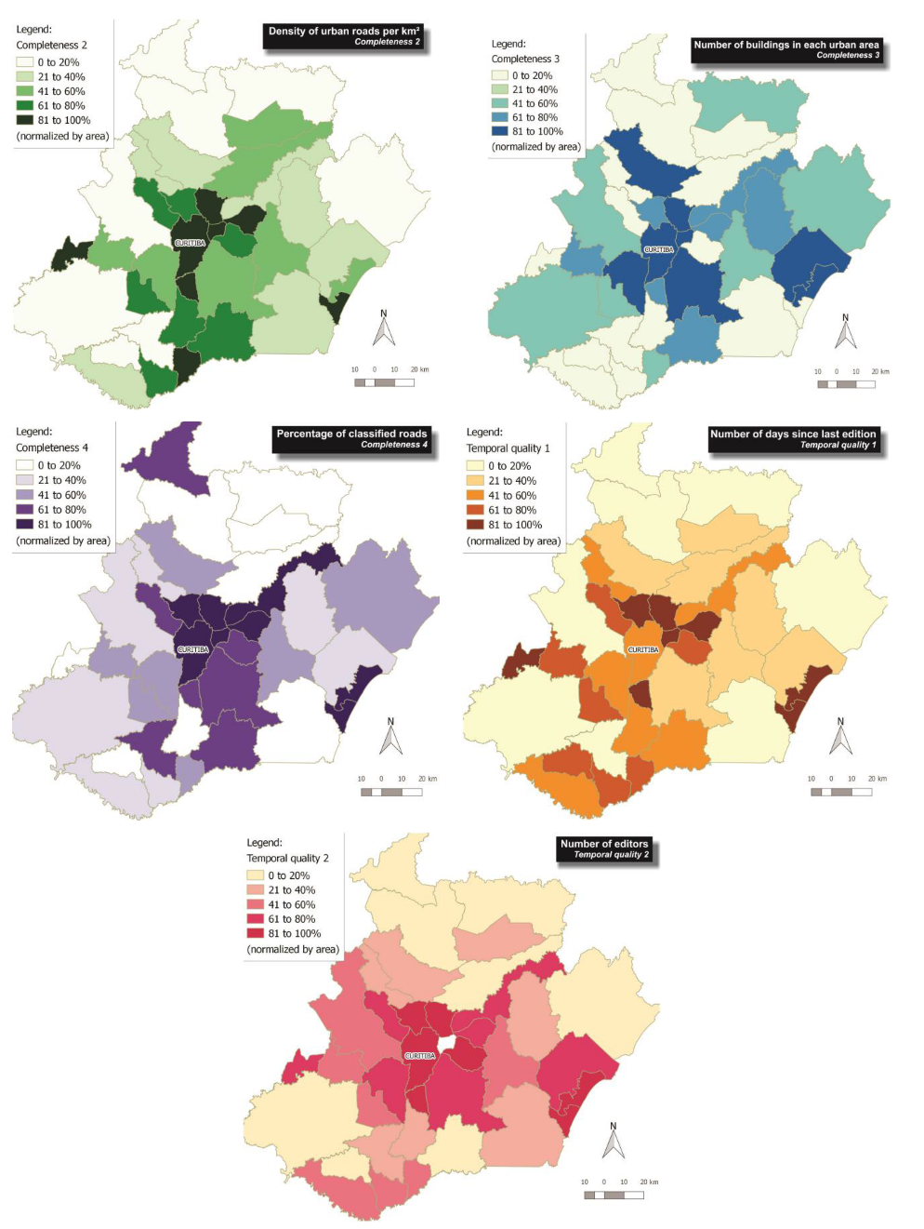
Data inequalities in OpenStreetMap

Slide 20
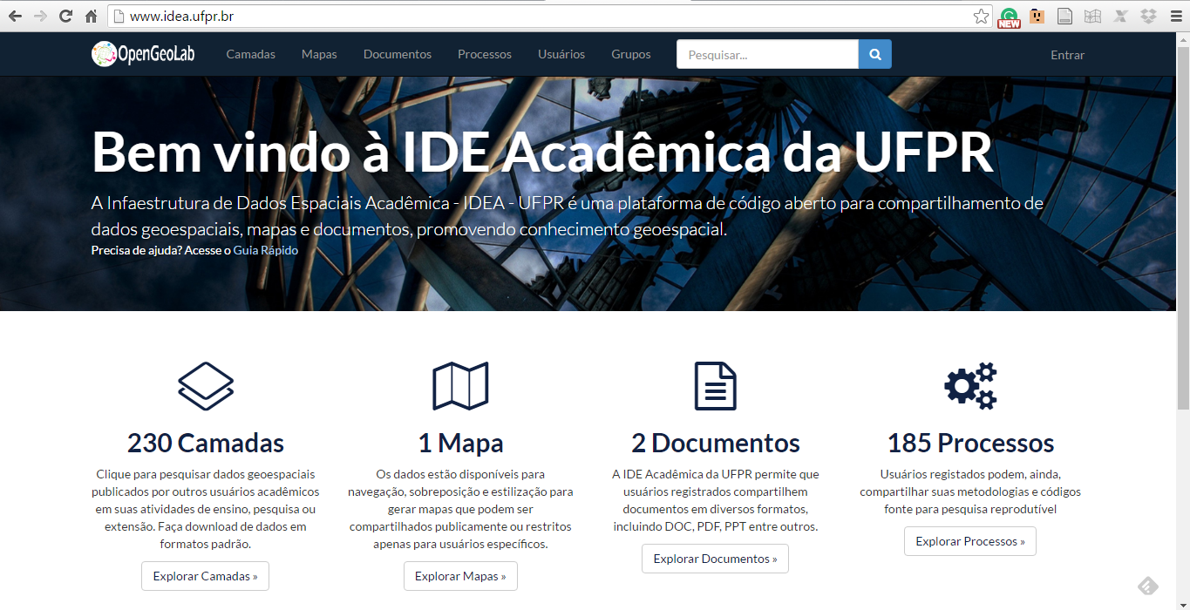

Current Research
Knowledge sharing: Academic And Reseacrh SDI
Can you help us? Online questionnaire: https://goo.gl/B8bJp8

Slide 21
Summarizing
Openness can help:
To visualize inequalities ...
To collaborate WITH communities...
To share knowledge...

Slide 22


ICC 2017 – SDI OPEN WORKSHOP!
LabGeolivre (www.labgeolivre.ufpr.br)
Geo4All (www.geoforall.org)
ICA Commission on Open Source Geospatial Technologies (http://opensourcegeospatial.icaci.org/)
Team:
Professors: Claudia Robbi Sluter and Luciene Delazari
Undergraduate and Graduate Students: João Vitor Meza Bravo, Everton Bortolini, Adriana Machado, Giovani Fronza, Raphael Campos, Eduardo Silvério, Talles di Cunto, Jaqueline Pisetta, Kelly Ferri
OBRIGADA!
Thank you!

